Slide 1



Restaurant Analysis
N. Ambarish
Data Analyst Internship

Slide 2
Introduction
In this internship, we have been provided with a Restaurant data from all over the world, to get insights from the type of food to the votes and prices and many more.
The entire data consist of total 9551 rows and 21 columns.
We did data cleaning and data pre-processing steps as needed.

Slide 3
Levels
Task 1 - Top Cuisines
Task 2- City Analysis
Task 3 - Price Range Distribution
Task 4 - Online Delivery
01
Task 1 - Restaurant Ratings.
Task 2 - Cuisine Combination
Task 3 - Geographic Analysis
Task 4 - Restaurant Chains
02
Task 1 - Restaurant Reviews.
Task 2 - Votes Analysis.
Task 3 - Price Range vs. Online Delivery and Table Booking.
03

Slide 4
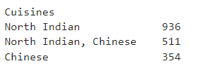
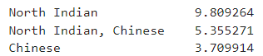
Task – 01 Top Cuisines
Level – 01
Determine the top three most common cuisines in the dataset.
Percentage of restaurant that serve the top cuisines

Slide 5
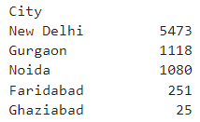
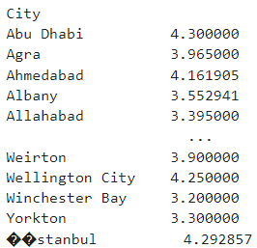
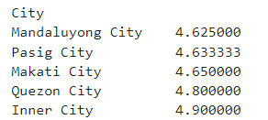
Task – 02 City Analysis
Level – 01
Identify the city with the highest number of restaurants in the dataset.
Calculate the average rating for restaurants in each city.
Determine the city with th highest average rating.

Slide 6
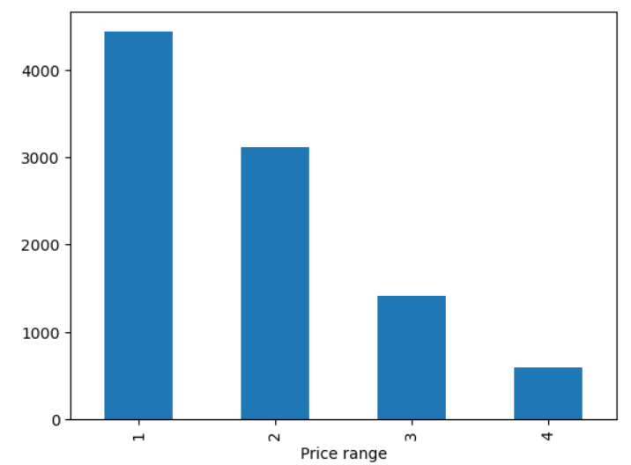
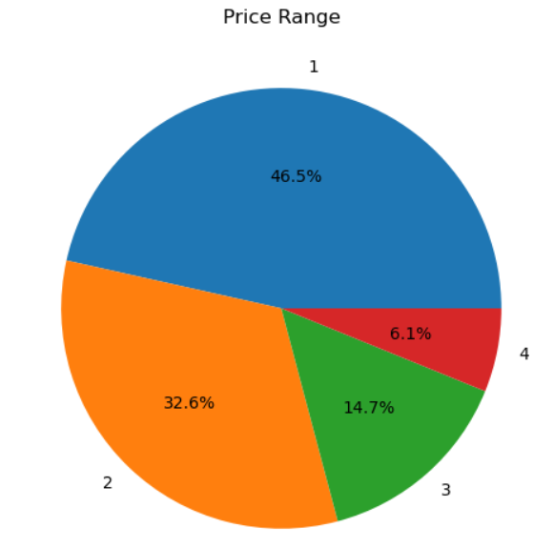
Task – 03 Price Range Distribution
Level – 01
Create a histogram or bar chart to visualize the distribution of price ranges among the restaurants.
Calculate the percentage of restaurants in each price range category.

Slide 7
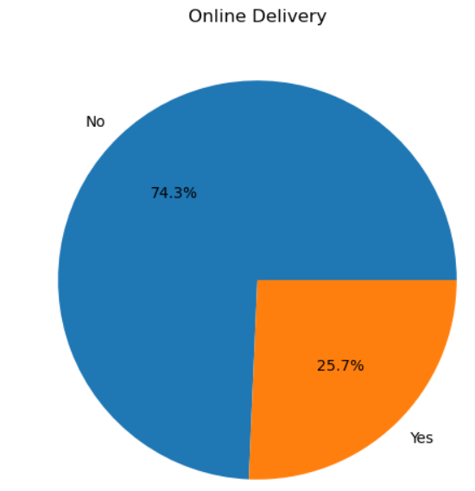
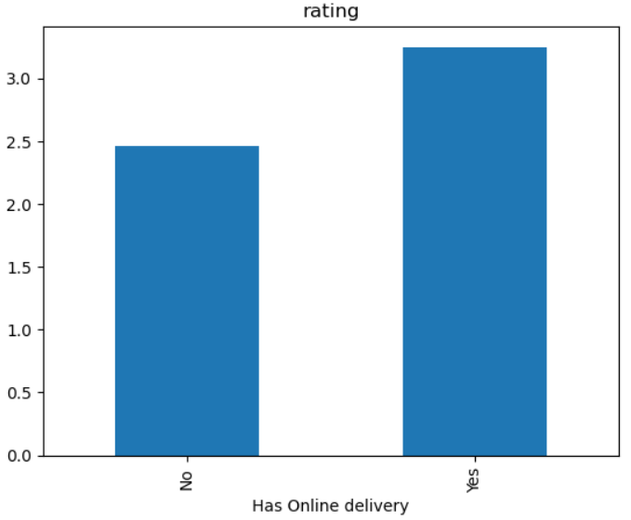
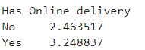
Task – 04 Online Delivery
Level – 01
Determine the percentage of restaurants that offer online delivery.
Compare the average ratings of restaurants with and without online delivery.

Slide 8
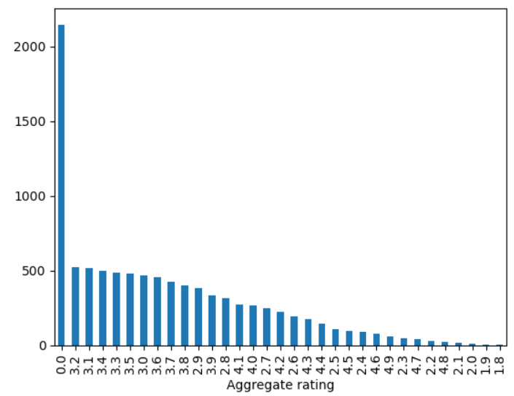
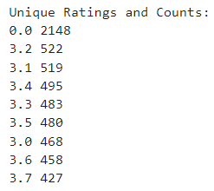
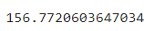
Task – 01 Restaurant Ratings
Level – 02
Analyze the distribution of aggregate ratings and determine the most common rating range.
Calculate the average number of votes received by restaurants.

Slide 9
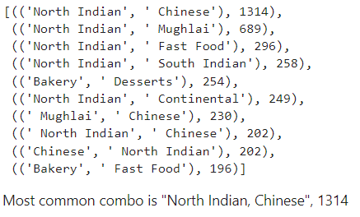
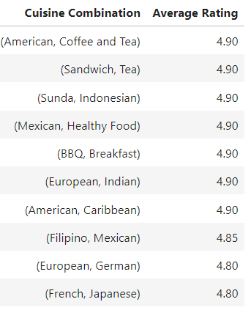
Task – 02 Cuisine Combination
Level – 02
Identify the most common combinations of cuisines in the dataset.
Determine if certain cuisine combinations tend to have higher ratings.

Slide 10
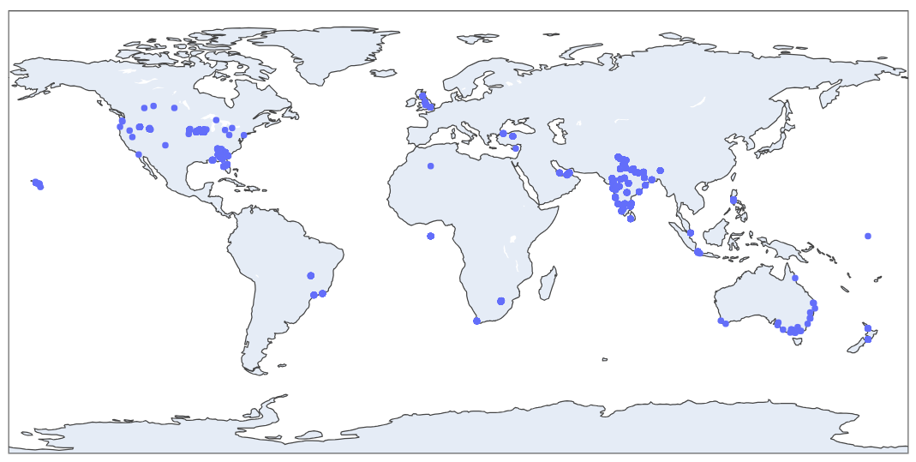
Task – 03 Geographic Analysis
Level – 02
Plot the locations of restaurants on a map using longitude and latitude coordinates.
Identify any patterns or clusters of restaurants in specific areas.
from the MAP we can see a cluster of restaurants from INDIA, Southeast AUSTRALIA, FLORIDA AND IOWA from USA.

Slide 11
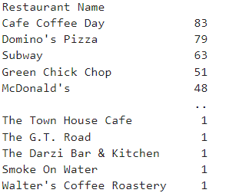
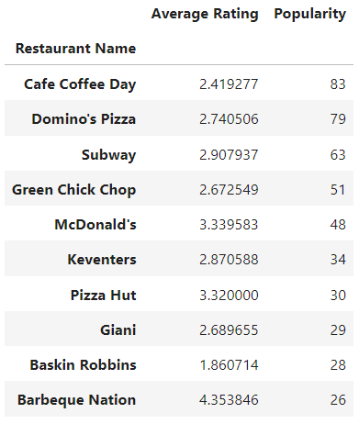
Task – 04 Restaurant Chains
Level – 02
Identify if there are any restaurant chains present in the dataset.
Analyze the ratings and popularity of different restaurant chains..

Slide 12
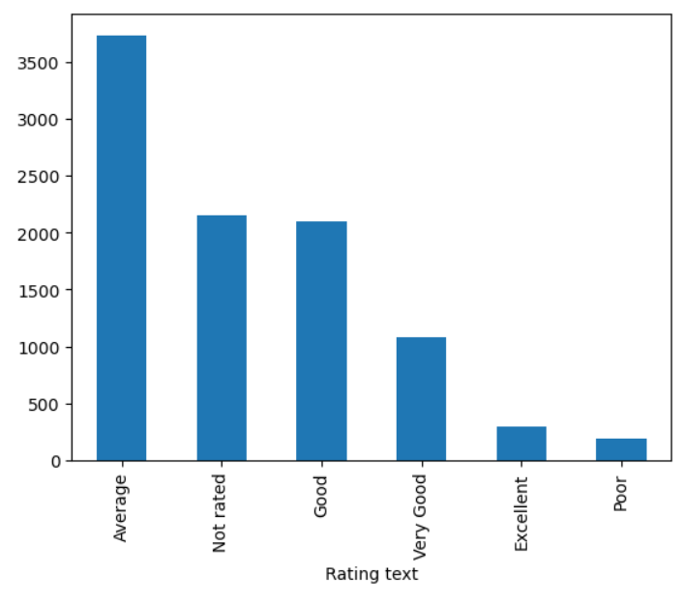
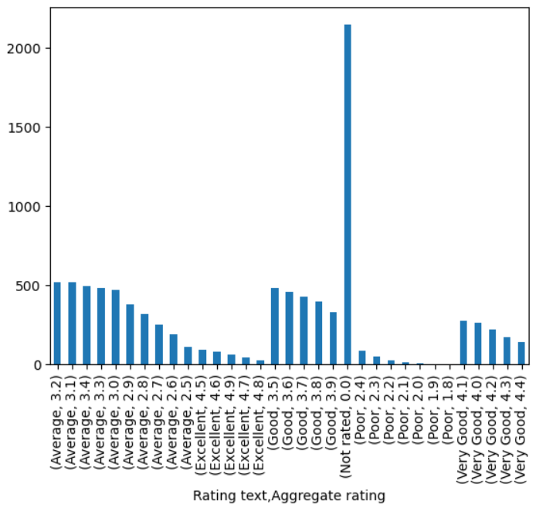
Task – 01 Restaurant Reviews
Level – 03
Analyze the text reviews to identify the most common positive and negative keywords
Calculate the average length of reviews and explore if there is a relationship between review length and rating.

Slide 13
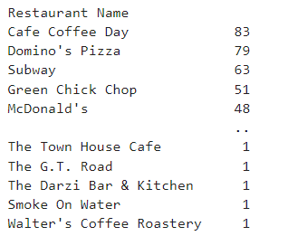
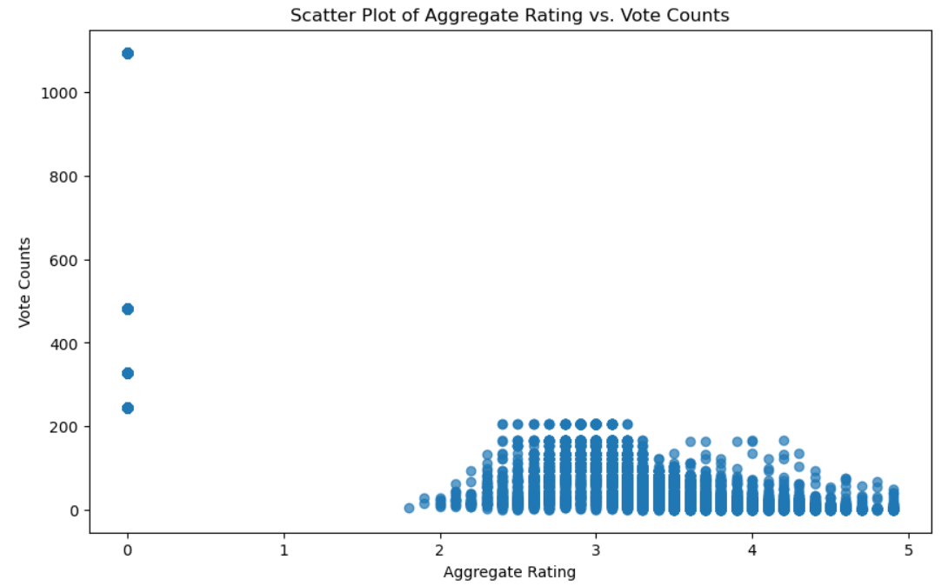
Task – 02 Votes Analysis
Level – 03
Identify the restaurants with the highest and lowest number of votes.
Analyze if there is a correlation between the number of votes and the rating of a restaurant.

Slide 14
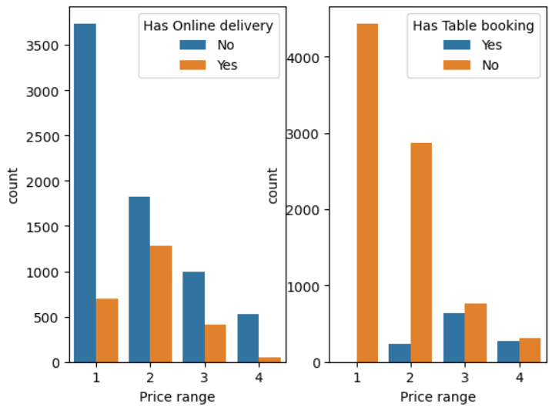
Task – 03 Price Range vs. Online Delivery and Table Booking
Level – 03
Analyze if there is a relationship between the price range and the availability of online delivery and table booking.
Determine if higher-priced restaurants are more likely to offer these services.
the higher-priced restaurants offer these service in less compared to the restaurants that are in the mid-price ranged

Slide 15
Thank you

